Slide 1

Department of Computer Science and Engineering
Lightweight Blockchain-Enabled Federated Deep Learning with Differential Privacy for Secure Healthcare IoT Networks
PRESENTED BY
Gujjarlapudi Keerthana Lazarus (22471A05M5)
Gali Lakshmi Thirupathamma (22471A05M1)
Budala Jayabharathi (22471A05L5)
Chitirala John Wesly (22471A05L8)
Under the Guidance of,
Dr. R. SatheesKumar, B.Tech
Assistant Professor,
Department of Computer Science and Engineering,
Narasaraopeta Engineering College (Autonomous), Narasaraopet- 522 601.
Review No.
Department of CSE

Slide 2
OUTLINE
Abstract
Introduction
Literature Survey
Research Gaps
Problem Statement
Objectives
Block Diagram / Flow Diagram
Methodology
Implementation
Results and Analysis
Conclusion & Future Scope
References
Question and Answers
Acknowledgements
Review No.
Department of CSE

Slide 3
ABSTRACT
This project introduces LB-FDL (Lightweight Blockchain-Enabled Federated Deep Learning) with Differential Privacy (DP) for secure Healthcare IoT networks. It combines Blockchain for immutability, Federated Learning for decentralized model training, and Differential Privacy to protect sensitive patient information. The system uses MobileNet/EfficientNet and an Optimized Proof-of-Stake (PoS) consensus to reduce energy use and latency. Experiments show 98.32% accuracy, 30% faster convergence, and 20% lower communication cost. Overall, LB-FDL provides a scalable, secure, and privacy-preserving framework that allows healthcare devices to collaborate safely without sharing raw medical data.
Review No.
Department of CSE

Slide 4
INTRODUCTION
Brief Introduction to the Project
Blockchain :
Provides a tamper-proof, transparent ledger that secures every transaction or model update, making data manipulation nearly impossible in healthcare IoT.
Eliminates the need for a central authority by distributing trust across nodes, reducing insider threats and ensuring reliable, verifiable data sharing.
Federated Learning :
Trains models locally on IoT devices so raw patient data never leaves its source, strengthening privacy while still contributing to a global model.
Reduces communication load and avoids single points of failure, enabling secure collaboration among many heterogeneous healthcare devices.
Differential Privacy:
Adds carefully calibrated noise to model updates so no individual patient record can be reverse- engineered, even during adversarial attacks.
Protects sensitive health information while maintaining strong model accuracy, making federated learning safer for large-scale healthcare IoT systems.
Review No.
Department of CSE

Slide 5
LITERATURE SURVEY
No | Title | Author | Journal Name & Year | Methodology Adapted | Key Findings | Gaps
1 | A blockchain based federated deep learning model for secured data transmission in healthcare IoT networks | Ganapathy et al., 2024, Measurement: Sensors | https://doi.org/10.1016/j.measen.2024.101176 | BLSTM, Federated Learning, Blockchain (PoW), Smart Contracts | Achieved 97.16% accuracy in normal class, used ToN-IoT dataset; ensured secure decentralized FL using blockchain | High computational cost, lacks lightweight optimization, no differential privacy
2 | A secure data transmission framework for IoT enabled healthcare | Sohail Saif et al., 2024, Heliyon (Elsevier) | https://doi.org/10.1016/j.heliyon.2024.e36269 | Timestamp-based Secret Key Generation (T-SKG), DES (ECB, CBC, CTR) modes | Used SKG-based encryption with 64-bit hex keys, ensuring 99.97% PDR, 8.83 ms delay, and strong resistance to guessing and brute-force attacks. | No blockchain or federated learning used; DES has known vulnerabilities; synchronization dependency between sender & receiver clocks
3 | Secure Data Delivery in a Software-Defined Wireless Body Area Network | M. S. Obaidat et al., 2022, Sensors (MDPI) | https://jtit.pl/jtit/article/view/1491/1340 | SDN architecture, Trust Management Scheme (TMS), EAP-AKA, AES encryption | Introduced SDN-based security in WBAN for improved reliability, low delay, and strong encryption using AES and EAP-AKA. | No blockchain or AI used; focused only on SDN + WBAN; no real-time deployment tested
4 | HIIDS: Hybrid Intelligent Intrusion Detection System Empowered with ML and Metaheuristic Algorithms for IoT-Based Healthcare | Sohail Saif et al., 2022, Microprocessors and Microsystems | https://doi.org/10.1016/j.micpro.2022.104622 | GA-DT, GA-kNN, PSO-DT, PSO-kNN, DE-DT, DE-kNN | GA-DT achieved 99.88% accuracy; minimal features (8–10) used; improved memory and execution time; applicable to IoT-healthcare | No real-time deployment; only NSL-KDD dataset used; blockchain not considered; lacks network-side validation
5 | Blockchain Technology in Healthcare: A Systematic Review | Cornelius C. Agbo et al., 2019, Healthcare (MDPI) | https://doi.org/10.3390/healthcare7020056 | Literature Review – no specific algorithms implemented | Identified use cases in EMR, remote patient monitoring, drug supply chain; highlighted lack of implementations | Insufficient prototype applications; need for rigorous validation and real-world implementation studies
Review No.
Department of CSE

Slide 6
RESEARCH GAPS
Research Gap in Paper 1:
High computational cost, lacks lightweight optimization, no differential privacy.lightweight deep-learning models and proper privacy protection, making it too slow and insecure for IoT devices.
Research Gap in Paper 2:
No blockchain or federated learning; DES is weak; relies on synchronized clocks.blockchain and federated learning and still depends on weak DES encryption, which reduces security and reliability.
Research Gap in Paper 3:
No blockchain or AI; only SDN+WBAN; no real-time testing.AI-based detection and blockchain support and is not tested in real-time healthcare IoT environments.
Research Gap in Paper 4:
No real-time deployment; uses only NSL-KDD; no blockchain; limited featureoptimization. modern datasets, blockchain integration, and efficient models, so it cannot be deployed in real IoT healthcare systems.
Research Gap in Paper 5:
Only a review, no implementation, no experiments, no algorithms.practical implementation, algorithms, and experimental validation, offering only theoretical discussion without proof.
Review No.
Department of CSE

Slide 7
PROBLEM STATEMENT
1. Research Gap Problem:
Existing work uses heavy models and has no strong privacy protection, so IoT devices struggle to process data safely.
Solution:
You use lightweight models (MobileNet/EfficientNet) and differential privacy, making the system fast, efficient, and secure for IoT healthcare.
2. Research Gap Problem:
Existing work lacks blockchain and federated learning, and relies on weak DES encryption, which reduces trust and security.
Solution:
You add blockchain with PoS and federated learning, replacing DES with strong cryptographic protection and secure decentralized training.
Review No.
Department of CSE

Slide 8
PROBLEM STATEMENT
3. Research Gap Problem
Existing work has no AI-based attack detection or blockchain support and isn’t tested in real healthcare IoT environments.
Solution:
You integrate AI models with GAN-based attack detection and use blockchain for tamper-proof updates, validating everything on real medical datasets.
4. Research Gap Problem
Existing work uses outdated datasets, lacks blockchain security, and depends on heavy algorithms, making real deployment impossible.
Solution:
You use real IoT healthcare datasets, lightweight deep-learning models, and blockchain to create a fast, scalable, real-world-ready system.
Review No.
Department of CSE

Slide 9
PROBLEM STATEMENT
5. Research Gap Problem:
Existing work is only theoretical with no implementation, algorithms, or experimental proof.
Solution:
You build a complete working system using FL, blockchain, PoS, DP, and lightweight models, proving its performance with 98% accuracy.
Review No.
Department of CSE

Slide 10
OBJECTIVES
Main Objective:
To develop a Lightweight Blockchain-Enabled Federated Deep Learning (LB-FDL) model with Differential Privacy for secure and privacy-preserving healthcare IoT systems.
Specific Objectives:
Protect patient data while sending and processing it in healthcare IoT networks.
Train models in a distributed way using federated learning so that raw data stays on local devices.
Use blockchain and PoS to keep all model updates tamper-proof, traceable, and secure.
Add differential privacy so that even shared model updates do not reveal any single
patient’s data.
Use lightweight deep models (like MobileNet/EfficientNet) to reduce
computation, speed up training, and cut communication cost compared to older BFL-hIoT models.
Review No.
Department of CSE

Slide 11
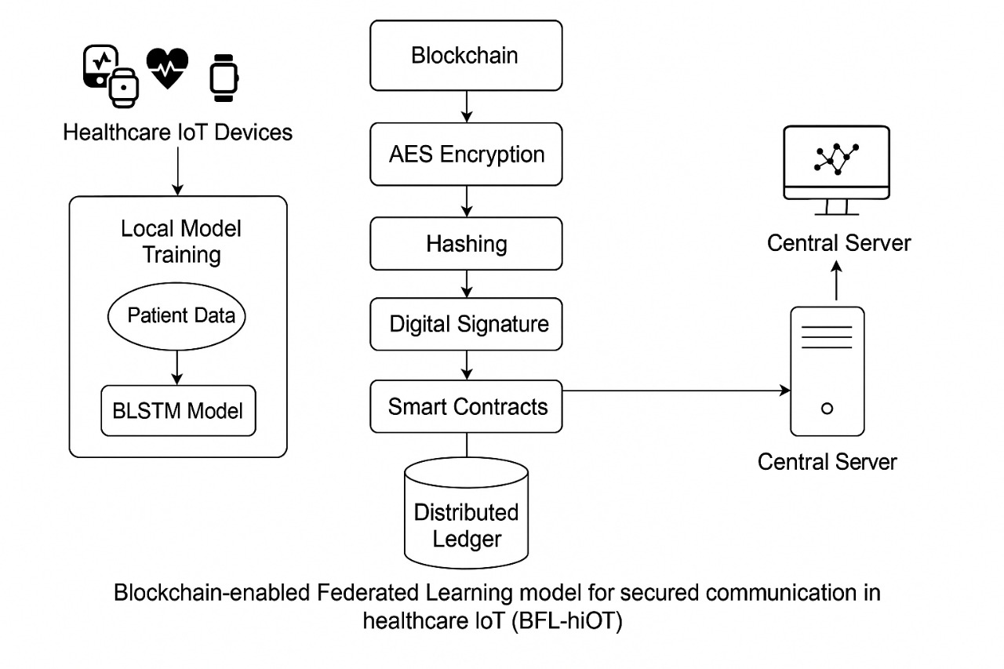
BLOCK DIAGRAM OR FLOW DIAGRAM
Collect data on devices – hIoT sensors and wearables collect patient data and keep it locally.
Train locally – each device trains a small deep learning model on its own data; no raw data goes to the cloud.
Add privacy – random noise is added to model updates so no single patient can be identified.
Send via blockchain – encrypted, signed updates are sent to blockchain where smart contracts verify them.
Build global model – server combines all valid updates into one global model.
Repeat in rounds – training, protecting, sending, and aggregating repeat
until the model is accurate
Review No.
Department of CSE

Slide 12
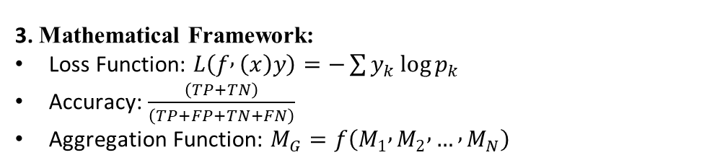
METHODOLOGY
1.Preprocessing:
Remove unwanted or missing data to keep the dataset clean.
Scale and normalize values so all features are in a similar range.
Convert text or category-based data into numbers the model can understand.
3. Mathematical Framework:
Loss Function: $L\left(f , \left(x\right)y\right)=−\sum{y_{k}}\log{p_{k}}$
Accuracy: $\frac{\left(TP+TN\right)}{\left(TP+FP+TN+FN\right)}$
Aggregation Function: $M_{G}=f\left(M_{1} , M_{2} , … , M_{N}\right)$
4. Algorithms:
Federated Learning (FL) – Trains the model on each device locally so patient data never leaves the device.
Proof-of-Stake (PoS) Blockchain – Verifies and stores model updates securely without heavy energy usage.
Differential Privacy (DP) – Adds small noise to model updates to protect sensitive medical information.
MobileNet/EfficientNet Models – Lightweight deep-learning models used for fast and accurate predictions on IoT devices.
2.Exploratory Data Analysis (EDA):
Examined the MIMIC-III, MIT-BIH, and ToN-IoT datasets to understand patterns in patient data and attack behavior.
Identified and cleaned missing, duplicate, and noisy entries to ensure accurate model training.
Noted that heavy attack categories like DoS, Backdoor, and XSS were more common, helping the model focus on critical threats.
Review No.
Department of CSE

Slide 13
IMPLEMENTATION
IoT devices trained local BLSTM / MobileNet models and shared encrypted updates.
Implementation:
Built the system using Python, TensorFlow, and Hyperledger Fabric to support federated learning and blockchain.
IoT devices trained lightweight models like MobileNet on their own data and sent only encrypted model updates, not raw data.
Smart contracts checked each update for safety and then saved it securely on the blockchain for tamper-proof storage.
Achieved 98.32% accuracy, 30% faster convergence, and 20% less communication cost.
Software Specification:
Operating System: Windows 10 / Ubuntu
Programming Language: Python 3.10
Frameworks: TensorFlow, Hyperledger Fabric
Libraries: NumPy, Pandas, Matplotlib, Scikit-learn
Hardware Specifications:
Processor: Intel i7 / AMD Ryzen 7
GPU: NVIDIA Tesla T4 (16 GB)
RAM: 16 GB
Storage: 256 GB SSD
Challenges & Solutions:
Challenge: High communication delay → Solution: Used Adaptive Weight Aggregation (AWA) to reduce communication load.
Challenge: Risk of patient data leakage → Solution: Applied Differential Privacy (DP) to protect sensitive information.
Challenge: High energy usage in blockchain → Solution: Used an optimized Proof-of-Stake (PoS) consensus for efficiency.
Challenge: Model overfitting on medical data → Solution: Used dropout and early stopping to keep the model stable.
Review No.
Department of CSE

Slide 14
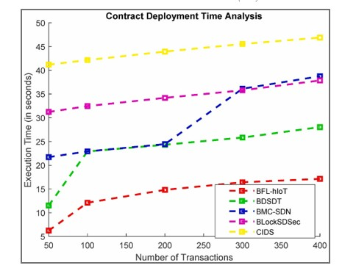
RESULTS & ANALYSIS
This graph shows how long different systems take to deploy a smart contract when the number of transactions increases.
BFL-hIoT (Blockchain-enabled Federated Learning for Healthcare Internet of Things) has the lowest execution time, staying between 8 to 17 seconds even when transactions increase. This means it is the fastest and most efficient among all systems.
BDSDT (Blockchain-based Data Sharing and Detection Technique) takes more time than BFL-hIoT but is still moderate, rising from around 10 to 28 seconds.
BMC-SDN (Blockchain-Managed Software Defined Networking) increases steadily from about 21 to 38 seconds as transactions grow, showing higher delay.
BLockSDSec (Blockchain-based Software-Defined Security) starts at about 31 seconds and rises to around 38 seconds, meaning it is slower and less scalable.
CIDS (Collaborative Intrusion Detection System) shows the highest delay, starting near 40 seconds and reaching close to 48 seconds, making it the slowest system.
Training vs Validation Accuracy and Loss Trends for LB-FDL
Review No.
Department of CSE

Slide 15
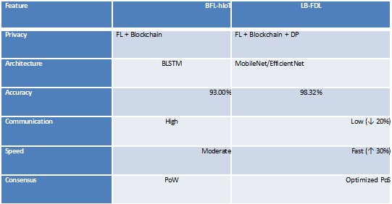
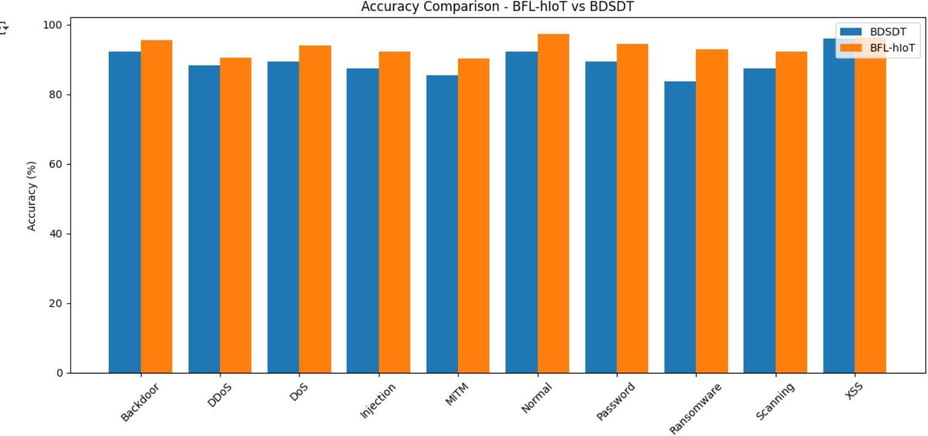
RESULTS & ANALYSIS
Table : Comparison of BFL-hIoT and LBFDL
This bar graph compares the accuracy of two models:
BDSDT (blue)
BFL-hIoT (orange)
Each pair of bars shows how well the two models perform on different attack types.
What it tells us:
The orange bars (BFL-hIoT) are slightly higher in most cases.
This means BFL-hIoT gives better accuracy than BDSDT for almost all attack types.
Both models still give high accuracy overall, but BFL-hIoT is more
consistent and performs better.
Review No.
Department of CSE

Slide 16
RESULTS & ANALYSIS
Privacy
BFL-hIoT: Uses federated learning with blockchain
LB-FDL: Adds extra privacy using differential privacy
Difference: LB-FDL protects user data better
Architecture
BFL-hIoT: Uses BLSTM model
LB-FDL: Uses lightweight models like MobileNet/EfficientNet
Difference: LB-FDL is less heavy and more efficient
Table : Comparison of BFL-hIoT and LBFDL
Review No.
Department of CSE

Slide 17
RESULTS & ANALYSIS
Accuracy
BFL-hIoT: About 93% accuracy
LB-FDL: About 98% accuracy
Difference: LB-FDL gives more correct results
Communication
BFL-hIoT: Needs more data exchange
LB-FDL: Needs less data exchange (around 20% less)
Difference: LB-FDL saves network bandwidth
Table : Comparison of BFL-hIoT and LBFDL
Review No.
Department of CSE

Slide 18
RESULTS & ANALYSIS
Speed
BFL-hIoT: Moderate processing speed
LB-FDL: Faster processing (around 30% faster)
Difference: LB-FDL works quicker
Consensus Method
BFL-hIoT: Uses Proof of Work
LB-FDL: Uses optimized Proof of Stake
Difference: LB-FDL is faster and uses less energy
Overall Difference
BFL-hIoT: Secure but slower and heavier
LB-FDL: More accurate, faster, and more efficient
Table : Comparison of BFL-hIoT and LBFDL
Review No.
Department of CSE

Slide 19
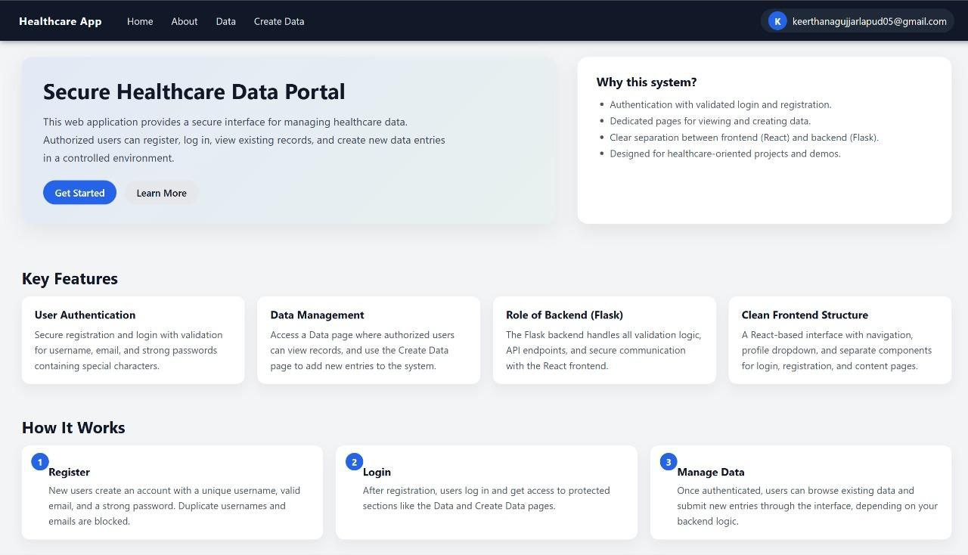
USER INTERFACES
Home Page – Secure Healthcare Data Portal:
Acts as the landing page of the healthcare web application
Introduces the system as a secure healthcare data management platform
Explains that only authorized users can access the system
Highlights the purpose of managing healthcare data safely
Displays key features like authentication and data management
Provides navigation links to Home, About, Data, and Create Data pages
Fig: Home Page

Slide 20
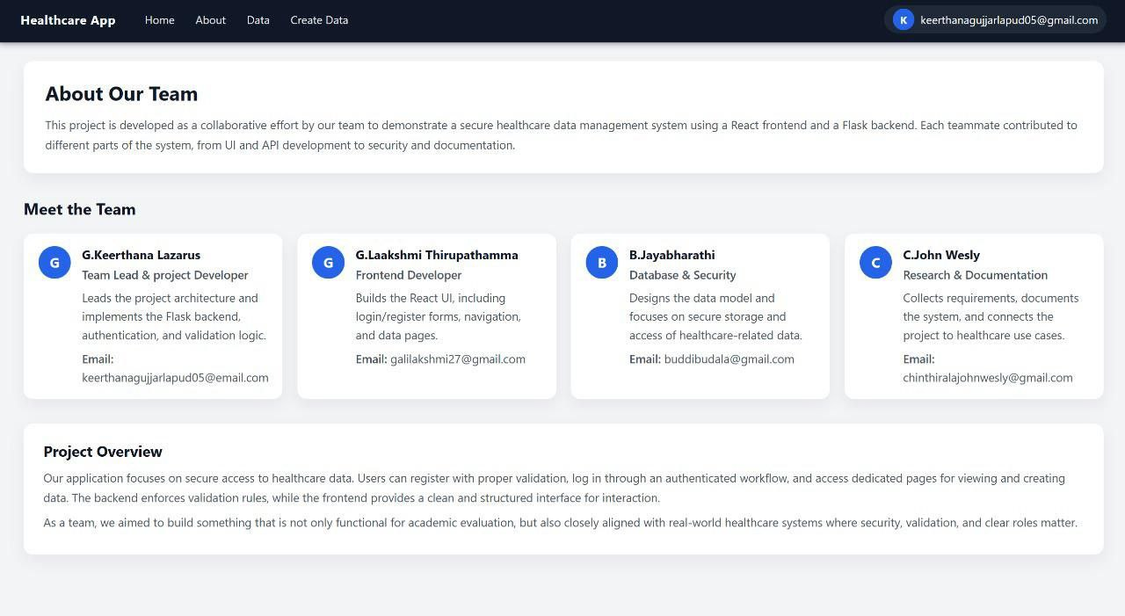
USER INTERFACES
About Page – Team and Project Overview:
Explains the overall goal of the healthcare application
Describes the project as a secure data management system
Displays team members involved in the project
Shows individual roles such as frontend, backend, and security
Mentions the use of React for frontend development
Mentions Flask as the backend framework for validation and APIs
Fig:About Page

Slide 21
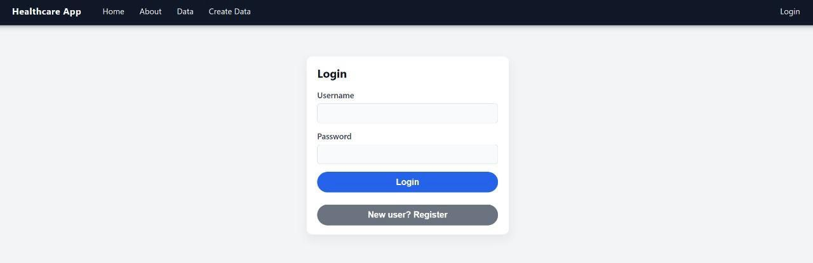
USER INTERFACES
Login Page:
Allows registered users to log into the system
Requires valid username and password for access
Prevents unauthorized users from accessing patient data
Ensures secure authentication of users
Provides a button for new users to register
Grants access to Data and Create Data pages after login
Fig:Login Page

Slide 22
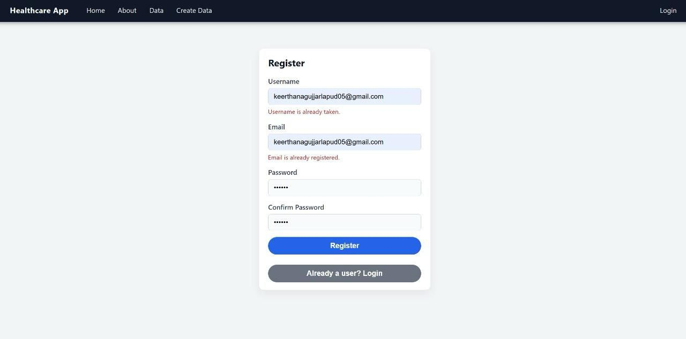
USER INTERFACES
Register Page:
Allows new users to create an account in the system
Requires a unique username and valid email address
Blocks duplicate usernames and email registrations
Enforces strong password validation rules
Includes password confirmation for accuracy
Provides a login option for existing users
Fig:Registration Page

Slide 23
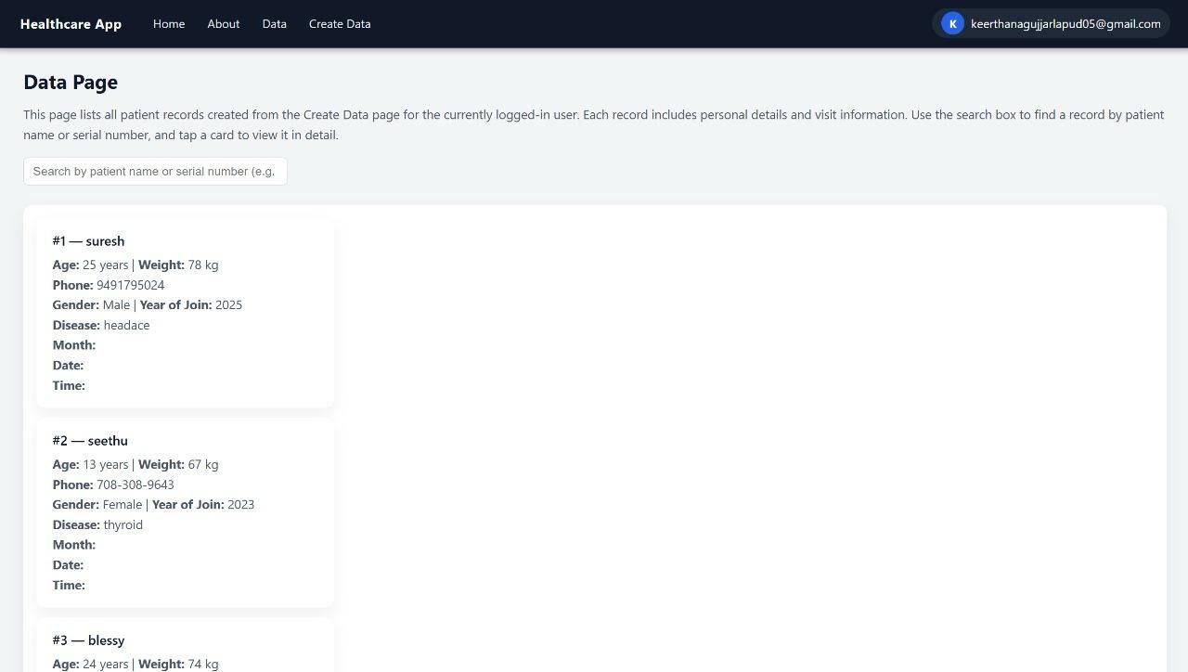
USER INTERFACES
Data Page – Patient Records:
Displays a list of patient records for the logged-in user
Shows basic patient details like age, weight, and gender
Displays disease and year of visit information
Uses a card-based layout for better readability
Includes a search bar to find patient records easily
Restricts access to authenticated users only
Fig:Data Page

Slide 24
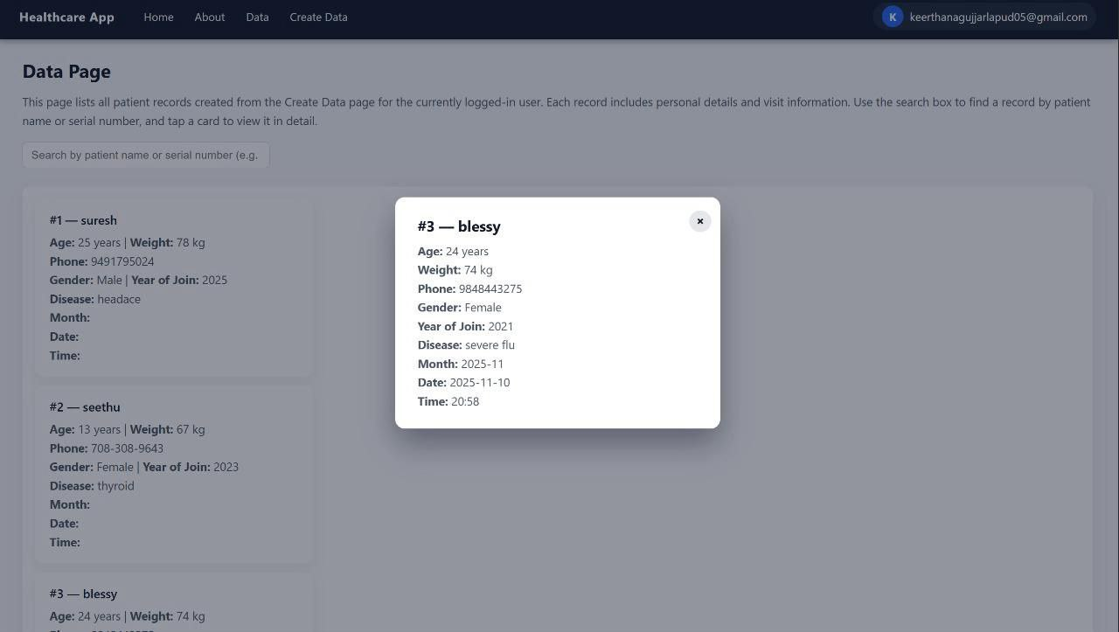
USER INTERFACES
Patient Detail Popup (Modal View):
Opens when a patient record card is clicked
Displays complete patient information in detail
Shows phone number, disease, date, and time
Uses a popup to avoid page redirection
Dims the background to focus on patient details
Allows users to close the popup and return to the data page
Fig: Patient Details Popup

Slide 25
CONCLUSION and FUTURE SCOPE
Key Findings:
Achieved 98.32% accuracy with faster convergence and less communication cost.
Combined Blockchain, Federated Learning, and Differential Privacy for secure IoT.
It learns well, shows good accuracy, and makes fewer mistakes over time.
Compared to older methods, it is faster, lighter, and uses less network data.
The approach is suitable for real healthcare systems, where both safety and accuracy are important.
Significance of Results:
Ensures data privacy and security in healthcare IoT networks.
Builds a trust-based decentralized system for medical data sharing.
It can detect attacks and still keep patient information safe.
Review No.
Department of CSE

Slide 26
CONCLUSION and FUTURE SCOPE
Future Developments:
The model can be improved by using more types of data, like medical images and reports.
It can be added to real hospital systems to help doctors make safer decisions.
The accuracy can be increased by using better tuning and training methods.
More explainable AI tools can be added so doctors can clearly understand why the model gives a result.
Limitations:
Requires high-end hardware for training blockchain-integrated models.
Minor latency overhead due to blockchain consensus validation
Performance may vary under heterogeneous network conditions and large-scale device diversity.
Review No.
Department of CSE

Slide 27
REFERENCES
[1] Ganapathy et al., "A blockchain based federated deep learning model for secure data transmission in IoT environment", Measurement: Sensors, 2024.
[2] Sohail Saif et al., "A secure data transmission framework for IoT enabled healthcare environment", Heliyon (Elsevier), 2024.
[3] Rashid et al., "Blockchain-based Secure Data Sharing Framework for Healthcare Applications", IJCA, 2024.
[4] Zhang et al., "A blockchainorchestrated deep learning approach for secure healthcare data exchange", Journal of Parallel and Distributed Computing, 2022.
[5] Rana et al., "Secure Data Delivery in a Software-Defined Wireless Sensor Network using Blockchain", Journal of Telecommunications and Information Technology, 2023.
[6] Alietal., "HIIDS: Hybrid Intelligent Intrusion Detection System using Block chain", Microprocessors andMicrosystems,2022.
[7] Kumar et al., "AI and Block chain Based Cloud-Assisted Secure Framework for Medical IoT", IEEE Internet of Things Magazine, 2021.
[8] Ghosh et al., "Efficient DCT-based Secret Key Generation for IoT Data Security", Ad Hoc Networks, 2018.
[9] Alhadhrami et al., "Blockchain Technology in Healthcare: A Systematic Review", Healthcare, 2019.
[10] M. Singh, G.S. Aujla, A. Singh, N. Kumar, S. Garg, “Deep-learningbased blockchain framework for secure software-defined industrial networks,
Review No.
Department of CSE

Slide 28
REFERENCES
[11]T. Li, A.K. Sahu, A. Talwalkar, V. Smith, “Federated learning: challenges, methods, and future directions,”
[12]T.M. Booij, I. Chiscop, E. Meeuwissen, N. Moustafa, F.T. den Hartog, “ToN_IoT: The Role of Heterogeneity and the Need for Standardization of Features and Attack Types in IoT Network Intrusion Datasets,”
[13]M. Kamran, H.U. Khan, W. Nisar, M. Farooq, S.U. Rehman, “Blockchain and Internet of Things: A Bibliometric Study,”
[14] W. Zhang, Z. Wu, G. Han, Y. Feng, L. Shu, “LDC: A Lightweight DADA Consensus Algorithm Based on the Blockchain for the Industrial Internet of Things for Smart City Applications,”
[15] M.U. Hassan, M.H. Rehmani, J. Chen, “Privacy Preservation in Blockchain-Based IoT Systems: Integration Issues, Prospects, Challenges, and Future Research Directions,”
[16] P. Nirmala, et al., “An Artificial Intelligence Enabled Smart Industrial Automation System Based on Internet of Things Assistance,”
[17]R. Pavaiyarkarasi, et al., “A Productive Feature Selection Criterion for Bot-IoT Recognition Based on Random Forest Algorithm,”
[18] M. Sugadev, et al., “Implementation of Combined Machine Learning with the Big Data Model in IoMT Systems for the Prediction of Network Resource Consumption and Improving the Data Delivery,”
[19] M. Nofer, P. Gomber, O. Hinz, D. Schiereck, “Blockchain,”
[20] R. Nowrozy, A.S.M. Kayes, P.A. Watters, M. Alazab, A. Ng, M.J.M. Chowdhury, O. Maruatona, “A Blockchain-Based
Review No.
Department of CSE

Slide 29
QUESTIONS and ANSWERS
✨ Thank you for listening! ✨
We’ve shared our journey of building a secure and intelligent Healthcare IoT system using Blockchain, Federated Learning, and Differential Privacy.
Now it’s your turn — we’d love to hear your questions, thoughts, or suggestions. 💬
- DG1
Review No.
Department of CSE

Slide 30
ACKNOWLEGEMENTS
We sincerely thank our guide Dr. R. Sathees Kumar who supported and encouraged us throughout our project journey.
Your guidance, feedback, and motivation helped us achieve this milestone.
This work on “Lightweight Blockchain-Enabled Federated Deep Learning with Differential Privacy for Secure Healthcare IoT Networks”
was made possible through constant learning, teamwork, and dedication.
Review No.
Department of CSE

